Slide 1
Data processing for tumor and t-cell detections
Yannis laaroussi
Bachelor thesis – initial presentation

Slide 2
About me
Yannis Laaroussi
20 years old
6th semester of Computer Science & Mathematics BSc

Slide 3
motivation
Link between biology/medicine and computer science
Learn python
Manipulate data
Notes:
Explain why I chose this topic.

Slide 4
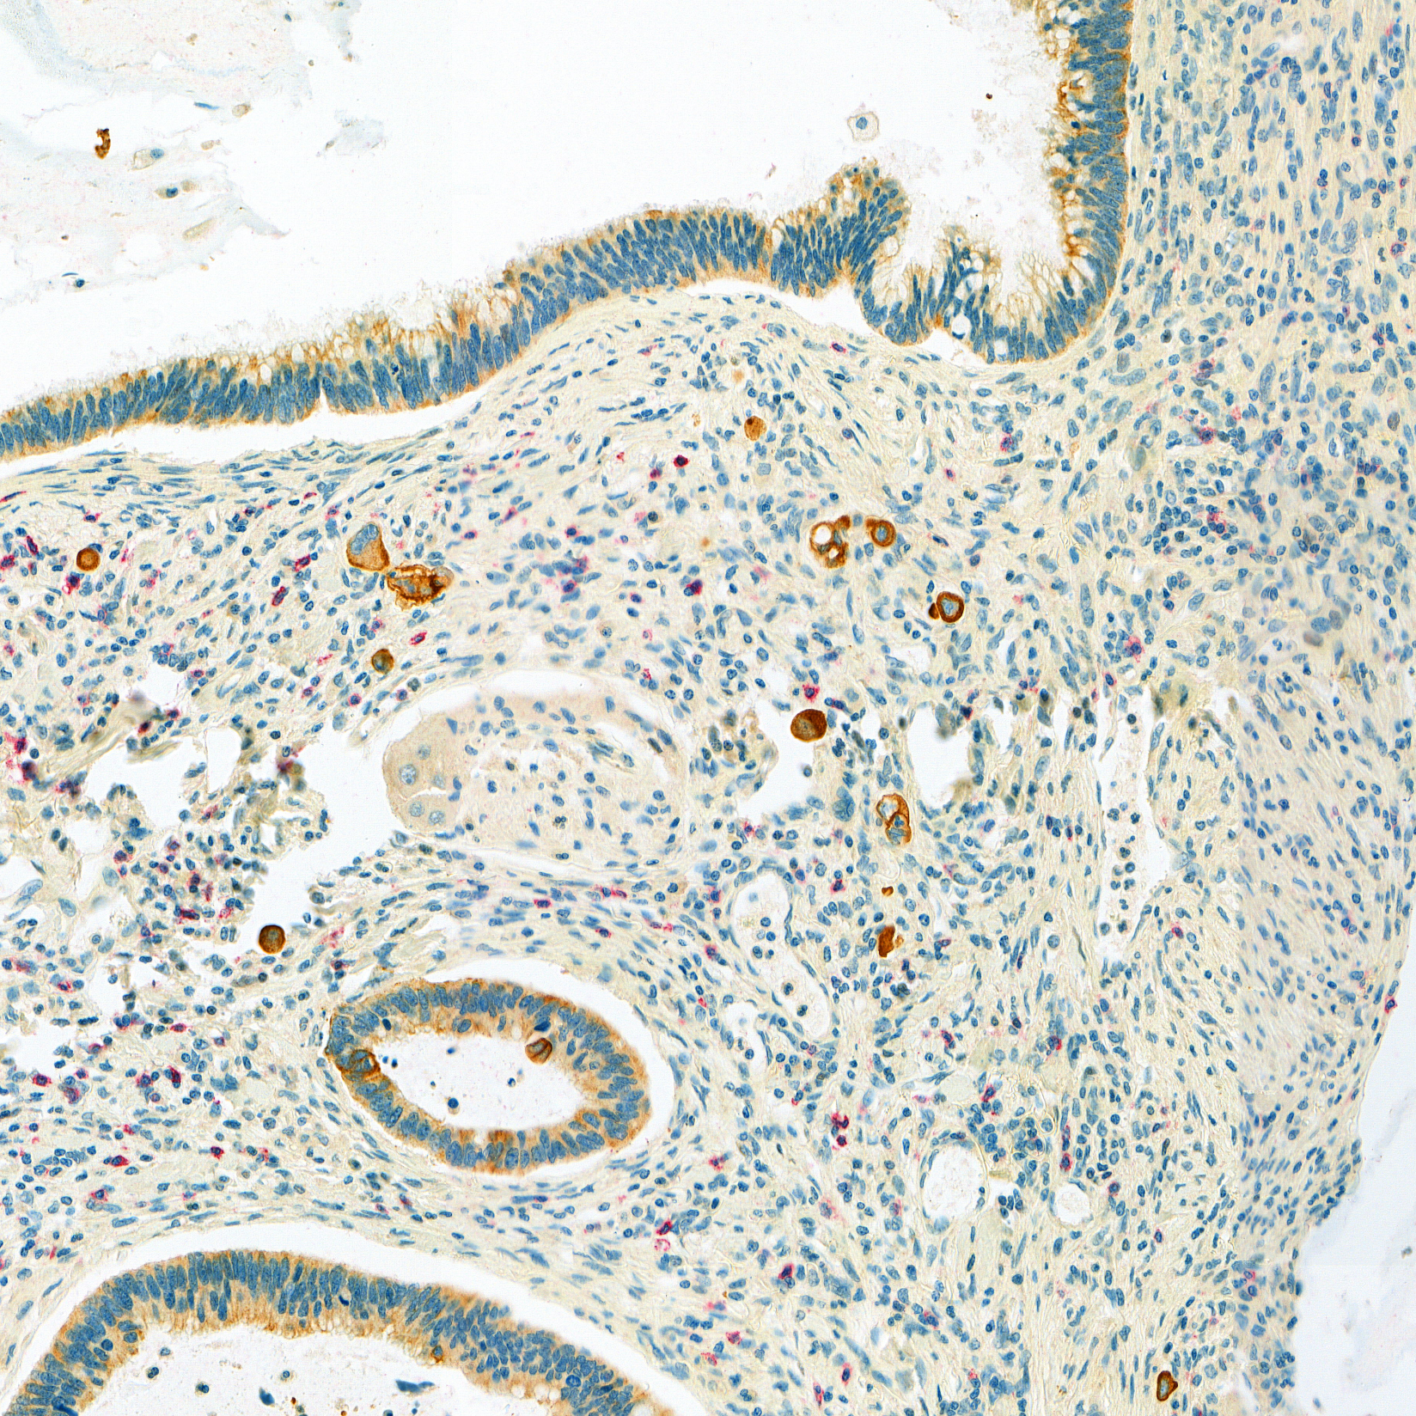
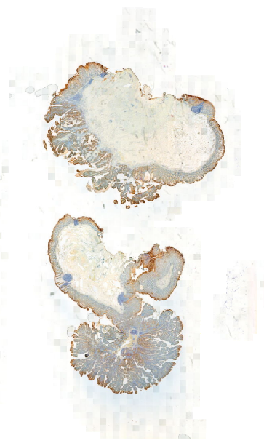
Context / Dataset overview
Tumor budding hotspot
png type
~340 images
3600 x 3600 pixels
Whole slide image
mrxs type
90’000 - 120’000 pixels
Note : images come from a fixed incisions of colon tissue

Slide 5
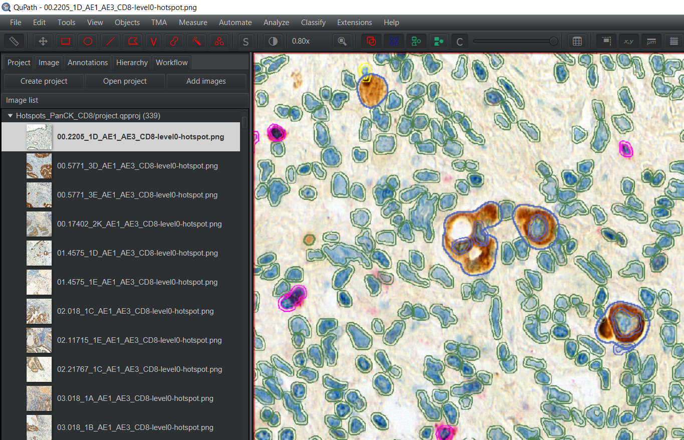
qupath
Tumor buds (brown spot)
Bounded by polygons
+ Extra information : perimeter, area, …
Notes:
Explain purpose of QuPath : software to visualize particular region. Tumor, Cells, bounded by polygons. Also we have some information about each cells like perimeter, area, center of mass, …

Slide 6
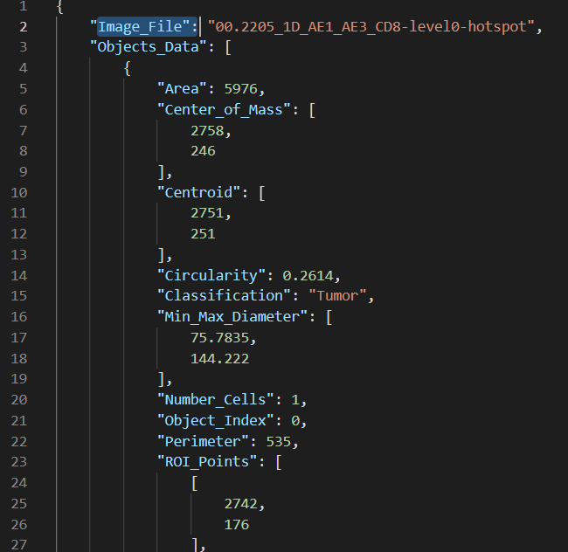
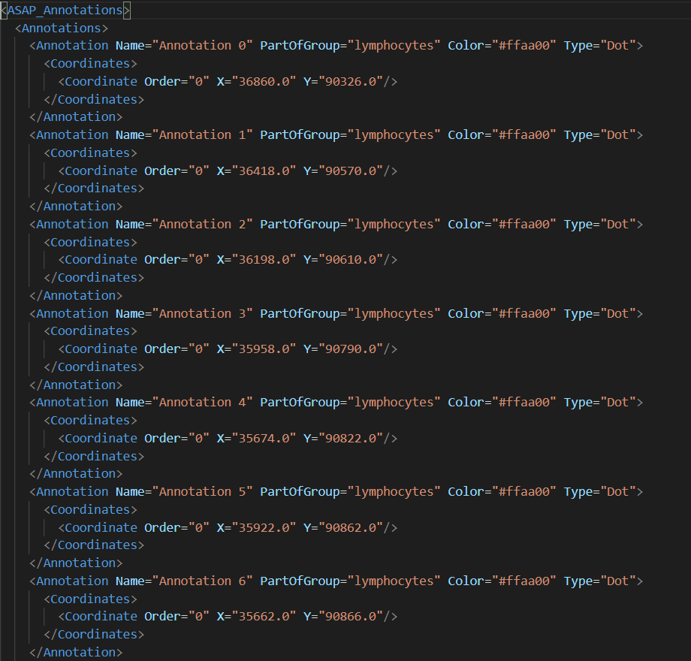
goal
JSON file (from QuPath)
XML file (coordinates)
Python Script
Notes:
Goal of the project, transform json file where we can fin information

Slide 7
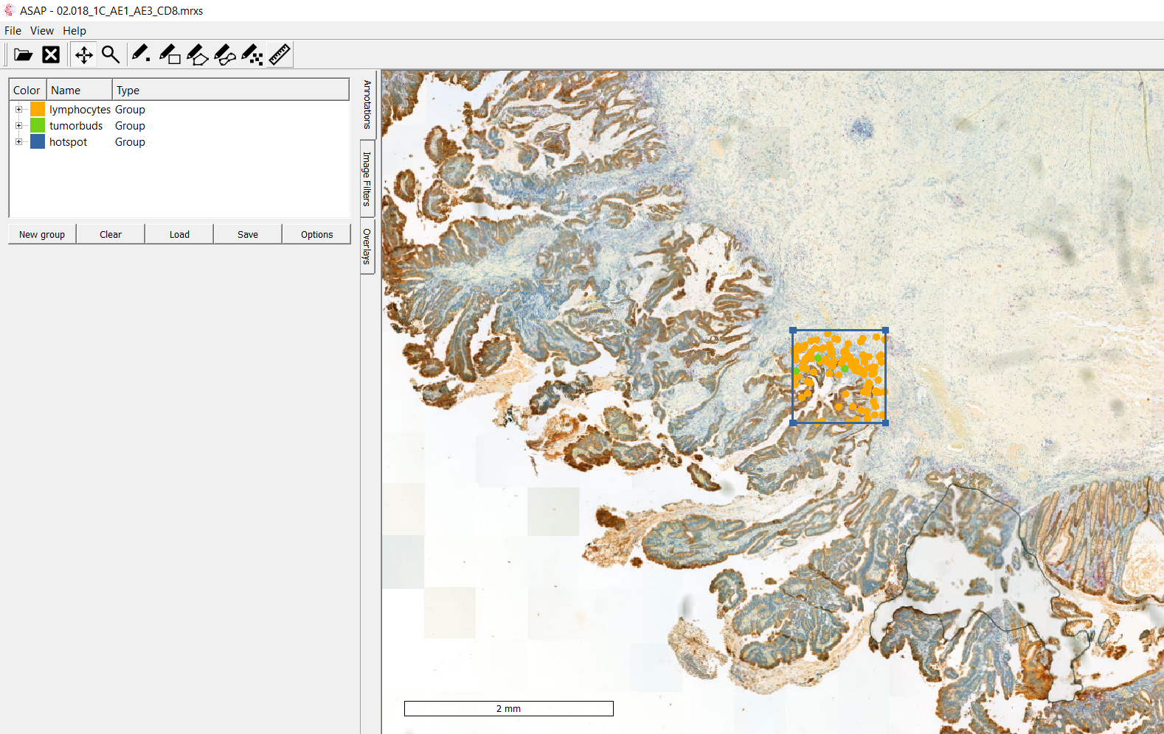
Asap
Visualisation using xml file on the whole slide image (mrxs format)
Notes:
Second software asap to use xml file in order to see on a full medical picture a particular hotspot, xml file used for phd project, whole slide image -> tumor budding hotspot

Slide 8

excel
JSON file to .CSV
Containing other features:
Perimeter, area, …
Python Script
Notes:
Second part : convert json file in .csv file in order to visualize data on an excel sheet, other features

Slide 9
Timeline
Preparation/Introduction to the subject | 21.02.2022 – 06.03.2022 | 3 weeks
Part 1 : JSON to XML | 07.03.2022 – 27.03.2022 | 3 weeks
Part 2 : JSON to EXCEL | 28.03.2022 – 17.04.2022 | 3 weeks
Part 3 : Writing | 18.04.2022 – 22.05.2022 (+ summer if needed) | 5 weeks

Slide 10
Questions ?

